Slide 1

A PERSONAL TRAINER APP TO SELF-TRAIN AND IMPROVE PRESENTATION SKILLS
21_22-J 02

Slide 2


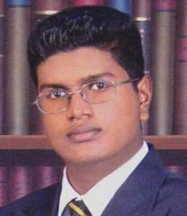
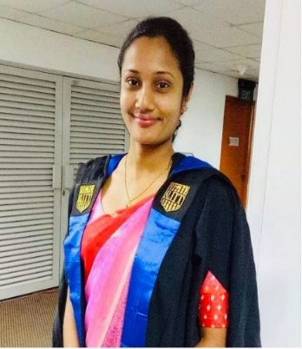
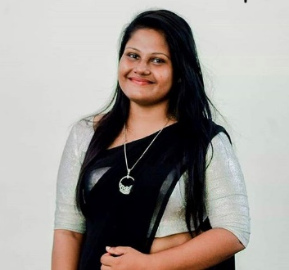
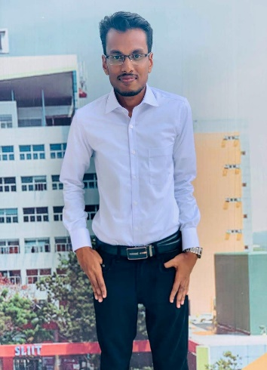
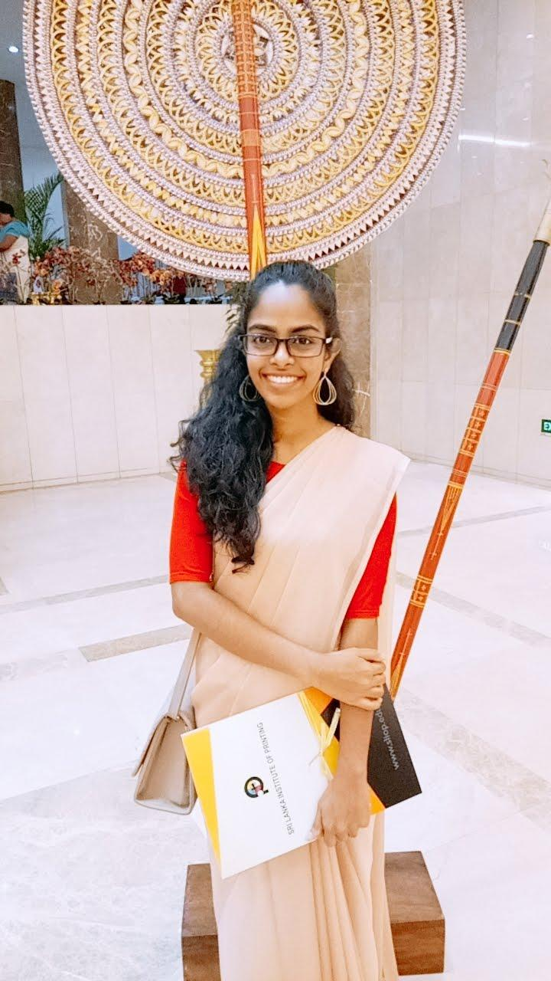
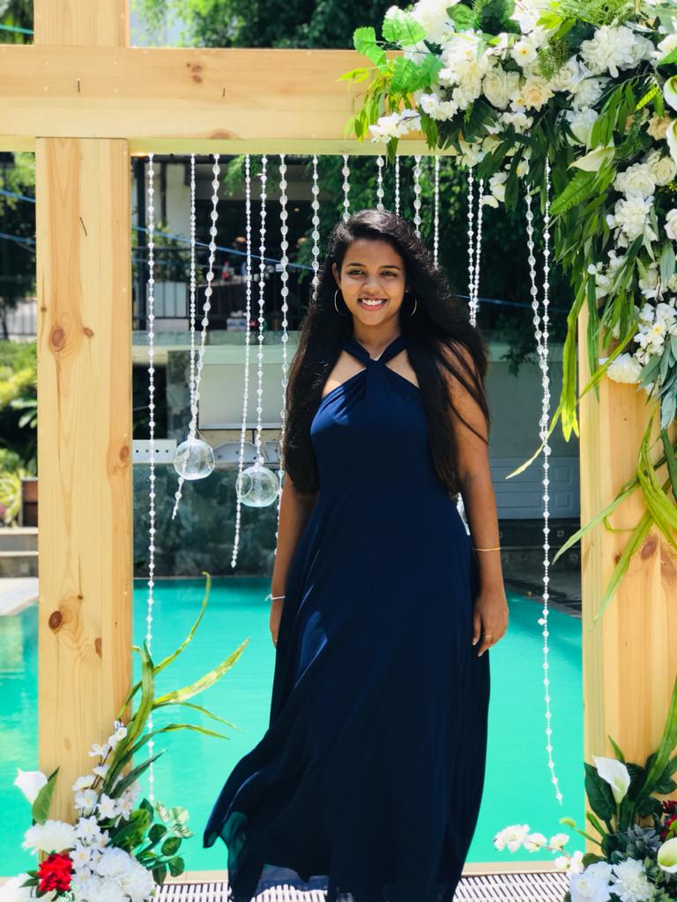
OUR TEAM
Dr. Shyam Mehraaj
Supervisor
Ms. Samanthi Siriwardene
Co-Supervisor
IT18205152
Shehara A.K.G.H.
IT18229912
Wanigasinghe N.T.
IT18227750
Wandana R.A.K.
IT17535090
Wedage C.V.

Slide 3
INTRODUCTION
The goal of doing a presentation is to attract the attention of the audience through a good delivery.
A good presentation should be written and delivered in error-free and comprehensible English, and the presenter should look well-prepared and rehearsed.

Slide 4
INTRODUCTION CONT.
People are accustomed to practicing presentations beforehand, preferably with a friend, roommate, or teammate who will listen.
The proposed system “Presently” will self-evaluate the presentation skills of an individual.

Slide 5

Is there a mechanism in place to evaluate presentation skills
in advance?

Slide 6
RESEARCH PROBLEM
Audio analyzing
PRONUNCIATION & VOCABULARY ERRORS
Audio analyzing
MIS MATCH & MATCH OF TOPIC TONE
Video analyzing
EMOTION DETECTION
Content analyzing
SLIDE QUALITY

Slide 7

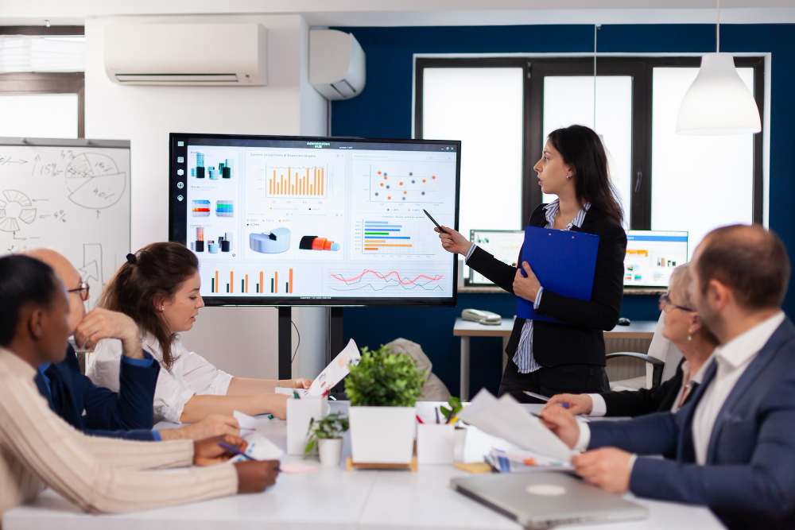
MAIN OBJECTIVE
To develop a Mobile Responsive Web Application to evaluate the presentation skills.

Slide 8
SUB OBJECTIVES
To provide a user with incorrect pronunciation and vocabulary mistakes and to detect the user what emotions and enhancements used to present the story.
To detect user, the match or mismatch between topic tone and emotions used to present the story.
To check the grammar and spellings in presentation slides
To suggest the user how to attract audience effectively by analyzing slides for accuracy of content and aesthetics using computer vision and rules of design-best-practices.

Slide 9
METHODOLOGY
Upload the video, audio and slides
Extract features
Analyze them
Provide Feedbacks

Slide 10
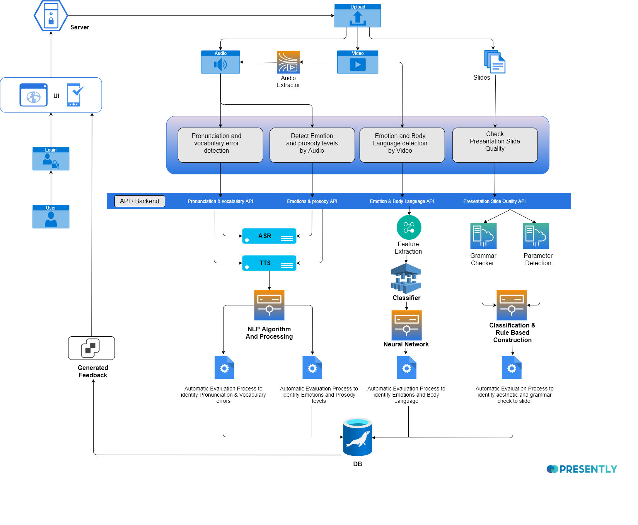
SYSTEM
OVERVIEW

Slide 11
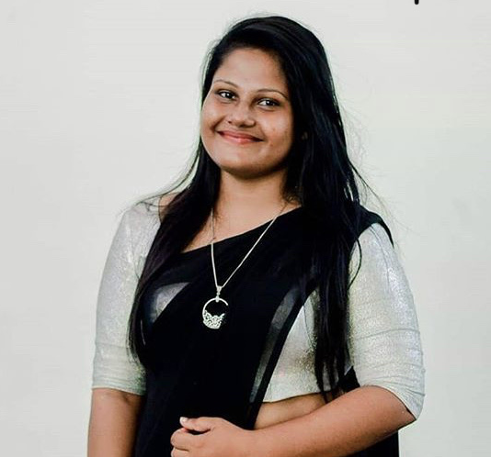
IT18205152 | Shehara A.K.G.H
Specializing in Software Engineering
Provide incorrect pronunciation and vocabulary mistakes

Slide 12
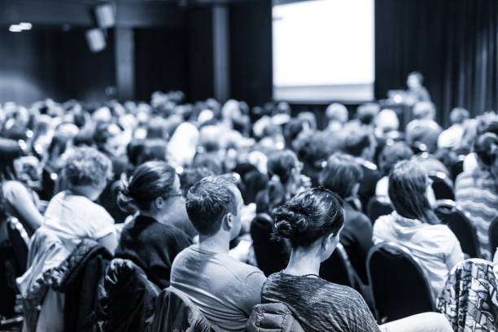
BACKGROUND
Rehearse before the presentation.
For effective communication, everyone should have a good vocabulary & correct pronunciation
IT18205152 | Shehara A.K.G.H. | 21_22-J 02

Slide 13
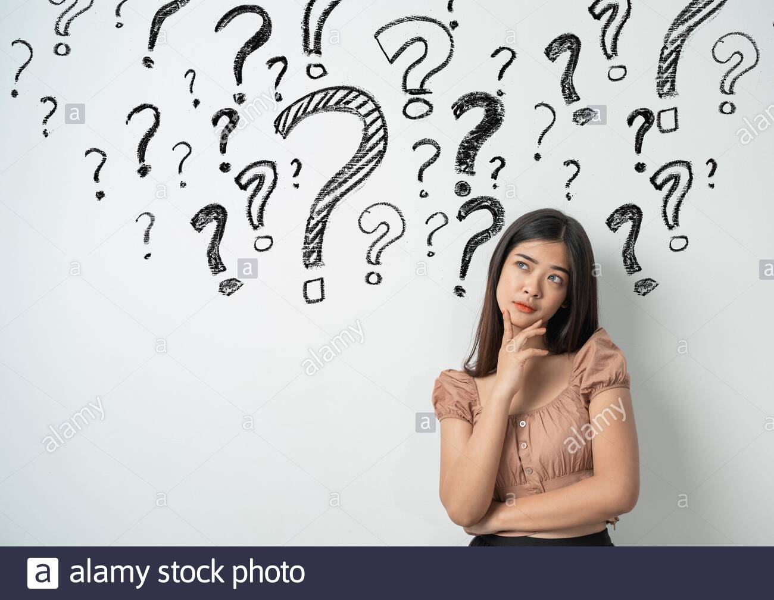
RESEARCH QUESTION
Identifying possible pronunciation issues that could arise throughout the presentation
Evaluation of grammatical mistakes in enhancing the audience's understanding of the presentation
IT18205152 | Shehara A.K.G.H. | 21_22-J 02

Slide 14
OBJECTIVES
Detection of the pronunciation mistakes that will occur during the presentation.
Analyzation of vocabulary errors to make the presentation more accurate to the audience.
IT18205152 | Shehara A.K.G.H. | 21_22-J 02

Slide 15

RESEARCH METHODOLOGY
IT18205152 | Shehara A.K.G.H. | 21_22-J 02

Slide 16
PROGRESS
Converted Speech to Text
Converted Text to speech
Audio Signal Analysis
Audio Comparison
Vocabulary Error Detection
Generating Feedbacks
System Integration
COMPLETED(50%)
90% Progress Presentation
Final Presentation
IT18205152 | Shehara A.K.G.H. | 21_22-J 02

Slide 17
CURRENT PROGRESS
Converted Speech to Text and Text to Speech
Environment setup to create Google cloud project
Enable Speech to Text Google APIs
Enable Text To Speech Google APIs
Creation of Service Account
Audio Preprocessing
Pre-emphasis of voice signal
Framing and windowing of voice signals
Applying Fourier-Transform and Power Spectrum to audio signals
Mel Frequency Cepstrum Coefficient Array computing filter banks
IT18205152 | Shehara A.K.G.H. | 21_22-J 02

Slide 18
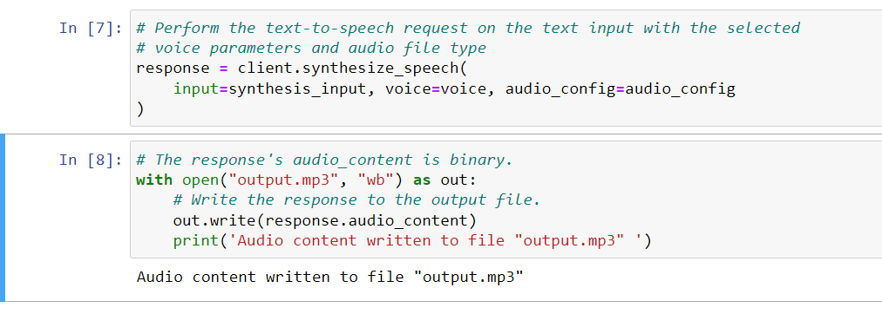
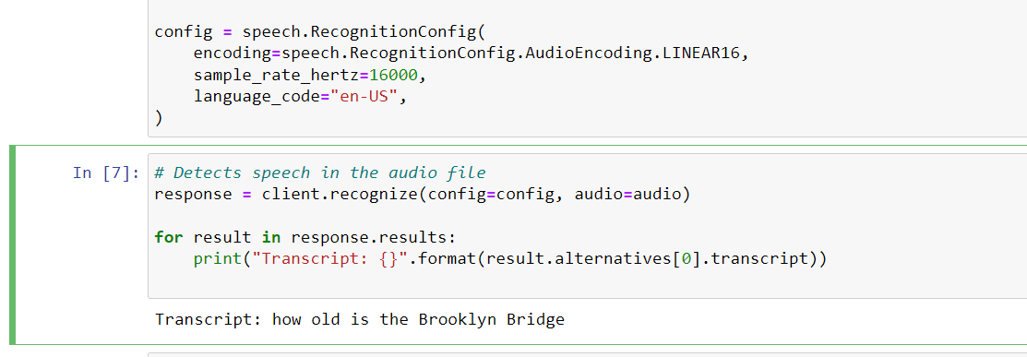
ACHIEVEMENTS
IT18205152 | Shehara A.K.G.H. | 21_22-J 02

Slide 19
TASKS TO BE COMPLETED
Audio Comparison
Vocabulary Error Detection
Audio Extraction
Feedback Generation
System Integration
IT18205152 | Shehara A.K.G.H. | 21_22-J 02

Slide 20



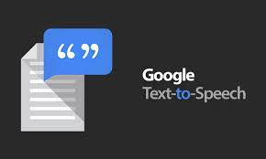


TOOLS & TECHNOLOGIES
Jupyter Notebook
Google API
Python 3.9
TensorFlow
IT18205152 | Shehara A.K.G.H. | 21_22-J 02

Slide 21
FUNCTIONAL REQUIREMENTS
NON-FUNCTIONAL REQUIREMENTS
The system will check for pronunciation and vocabulary issues using the audio file.
The system will provide feedback on the presenter's pronunciation and vocabulary errors.
Performance
Correctness
Availability
IT18205152 | Shehara A.K.G.H. | 21_22-J 02

Slide 22
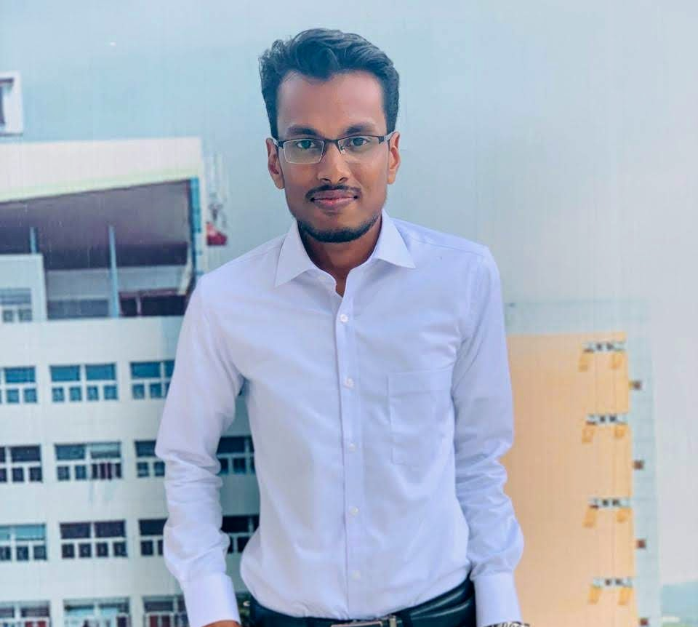
IT18229912 | Wanigasinghe N.T
Specializing in Software Engineering
Suggest the match or mismatch between topic tone and emotions

Slide 23
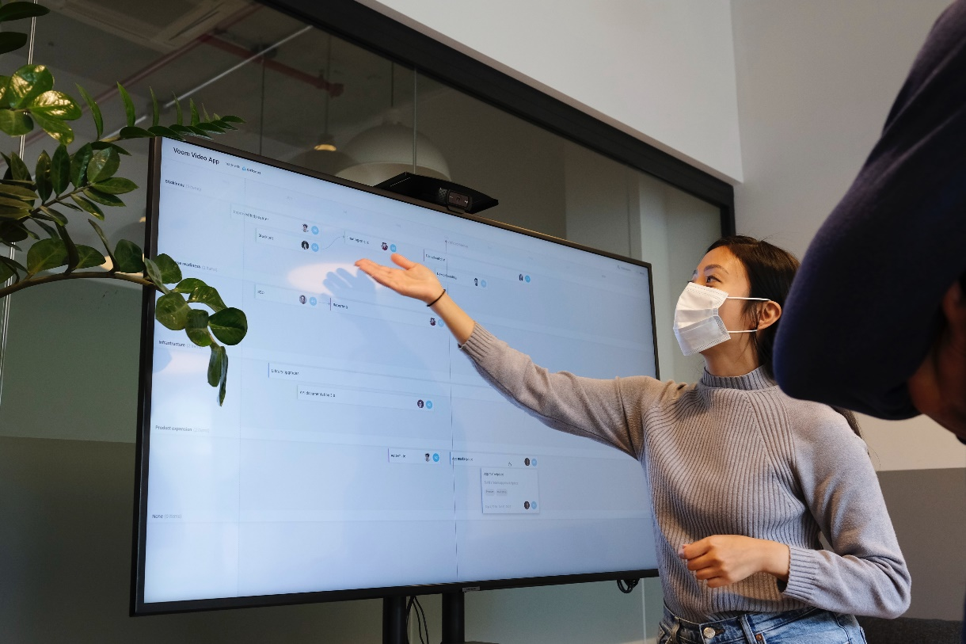
BACKGROUND
Should maintain tone, pitch and emotions controlled.
Performs the emotions and prosody naturalness of the presenter.
IT18229912 | Wanigasinghe N.T. | 21_22-J 02

Slide 24
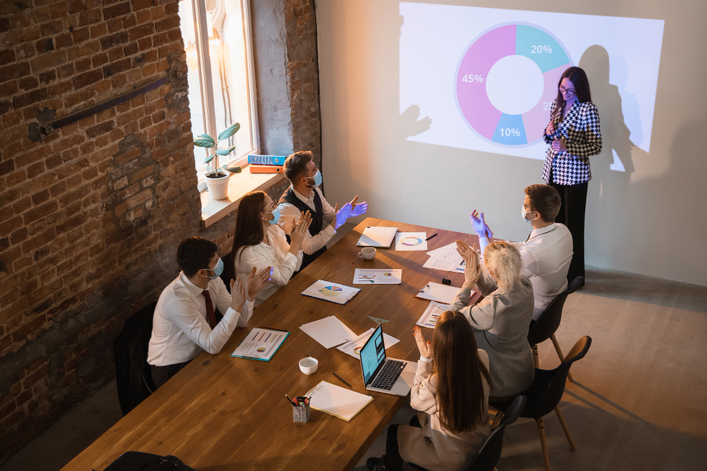
RESEARCH QUESTION
Inability of finding the match and mis match between the tone of the speaker.
Void of a system to detect the emotions during the presentation.
IT18229912 | Wanigasinghe N.T. | 21_22-J 02

Slide 25
OBJECTIVES
Implement more accurate and intelligent application to identify presenters’ emotion and prosody levels.
Analyse the match or mismatch between topic tone and emotions used to present the story.
IT18229912 | Wanigasinghe N.T. | 21_22-J 02

Slide 26
RESEARCH METHODOLOGY
IT18229912 | Wanigasinghe N.T. | 21_22-J 02

Slide 27
PROGRESS
Emotion Recognition model building
Train the model and predict emotions
Improve Data Augmentation
Overall accuracy increase
Build model for prosody checking
Build frontend for output
System integration for overall feedback
COMPLETED(50%)
90% Progress Presentation
Final Presentation
IT18229912 | Wanigasinghe N.T. | 21_22-J 02

Slide 28
CURRENT PROGRESS
Identified Datasets for emotions
UI implement for user input
Select feature extraction and create model
Train model
Take prediction
Evaluate and improvements
IT18229912 | Wanigasinghe N.T. | 21_22-J 02

Slide 29
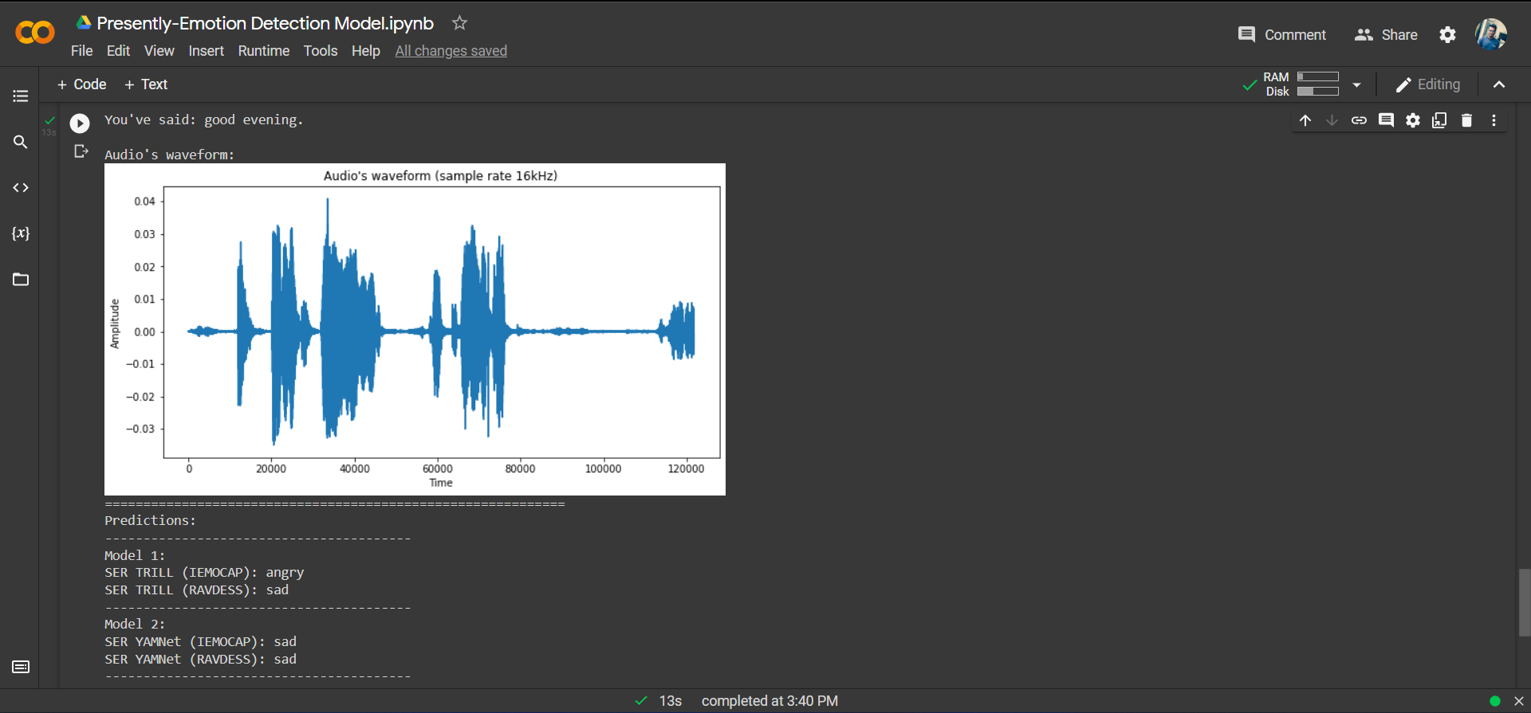
ACHIEVEMENTS
IT18229912 | Wanigasinghe N.T. | 21_22-J 02

Slide 30
TASKS TO BE COMPLETED
Model creation for prosody checking
Model combination
Improve accuracy
API creation and deployment
Build frontend for overall output
IT18229912 | Wanigasinghe N.T. | 21_22-J 02

Slide 31






TOOLS & TECHNOLOGIES
Python 3.9
Google Colab
Praat
Python Django
Bootstrap
TensorFlow
Google API
Fast API
IT18229912 | Wanigasinghe N.T. | 21_22-J 02

Slide 32
FUNCTIONAL REQUIREMENTS
NON-FUNCTIONAL REQUIREMENTS
Using the audio analysis system will provide the tonality and prosody errors.
Performance
Correctness
Availability
IT18229912 | Wanigasinghe N.T. | 21_22-J 02

Slide 33
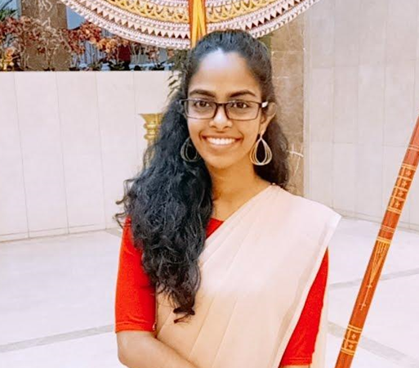
IT18227750 | Wandana R.A.K
Specializing in Data Science
Suggest the user what emotions and enhancements used to present the story

Slide 34
BACKGROUND
Emotions, body language, eye contact, maintaining a confident posture is important.
Speakers need to engage more with the audience and be confident during the presentation.
IT18227750 | Wandana R.A.K. | 21_22-J 02

Slide 35
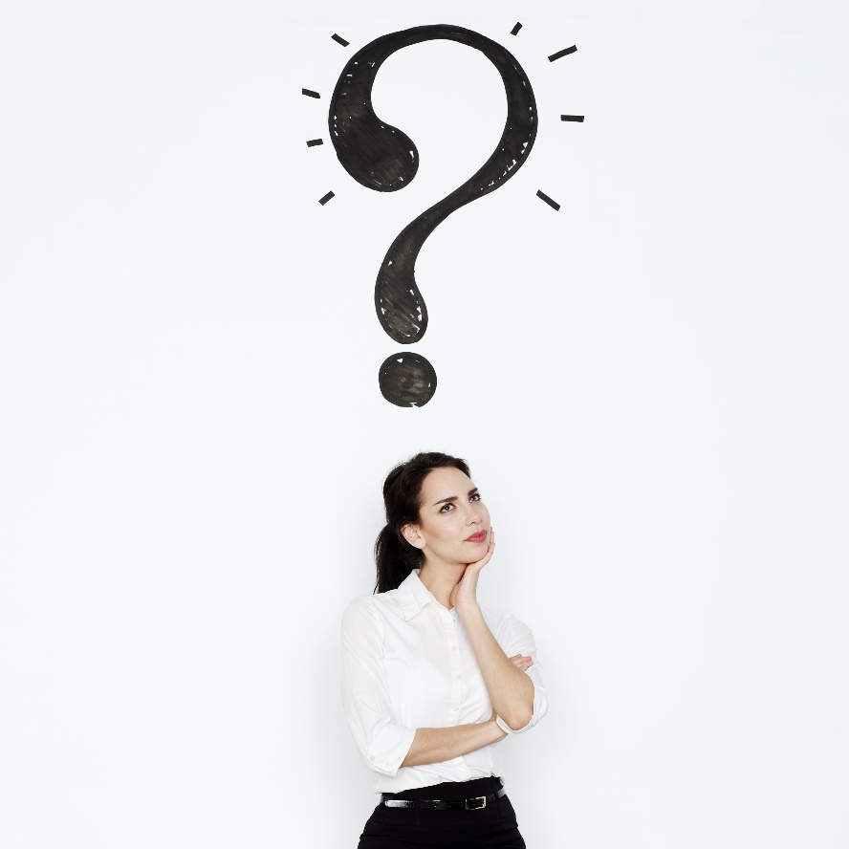
RESEARCH QUESTION
Inability to self-evaluate presenting emotions and body language postures due to a lack of an appropriate method or instrument.
IT18227750 | Wandana R.A.K. | 21_22-J 02

Slide 36
OBJECTIVES
To correctly extract the related emotions and body language postures.
Check whether the emotions and body language are presentation related.
IT18227750 | Wandana R.A.K. | 21_22-J 02

Slide 37
RESEARCH METHODOLOGY
IT18227750 | Wandana R.A.K. | 21_22-J 02

Slide 38
PROGRESS
Emotion Classification model building
Framewise emotion detection in video
Shoulder movements detection from the video
Unrelated emotion detection
Generating Feedbacks
System Integration
COMPLETED(50%)
90% Progress Presentation
Final Presentation
IT18227750 | Wandana R.A.K. | 21_22-J 02

Slide 39
CURRENT PROGRESS
Identified datasets for facial emotions
Emotion Classification Model Building using Convolutional Neural Network (CNN)
Detect Basic seven emotions from the video
Getting the most used Emotion in the video
IT18227750 | Wandana R.A.K. | 21_22-J 02

Slide 40
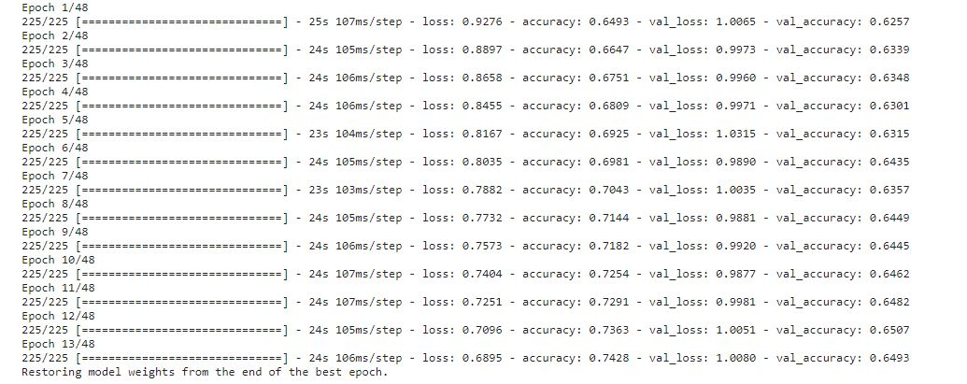
ACHIEVEMENTS
IT18227750 | Wandana R.A.K. | 21_22-J 02

Slide 41
TASKS TO BE COMPLETED
Improve model accuracy
Detecting unrelated emotions for the presentation
Detecting shoulder movements from the video to recognize the emotions
Feedback generation for the video
System Integration
IT18227750 | Wandana R.A.K. | 21_22-J 02

Slide 42



TOOLS & TECHNOLOGIES
Google Colab
Python 3.9
Open CV
TensorFlow
Keras
IT18227750 | Wandana R.A.K. | 21_22-J 02

Slide 43
FUNCTIONAL REQUIREMENTS
NON-FUNCTIONAL REQUIREMENTS
System will extract features from the uploaded video.
Performance
Correctness
Using video analysis system will detect presenters’ emotions and body gestures.
Availability
IT18227750 | Wandana R.A.K. | 21_22-J 02

Slide 44
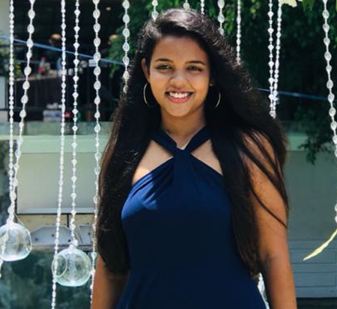
IT17535090 | Wedage C.V
Specializing in Data Science
Suggest the user how to attract audience effectively by analyzing slides for accuracy of content and aesthetics
IT17535090 | Wedage C.V. | 21_22-J 02

Slide 45
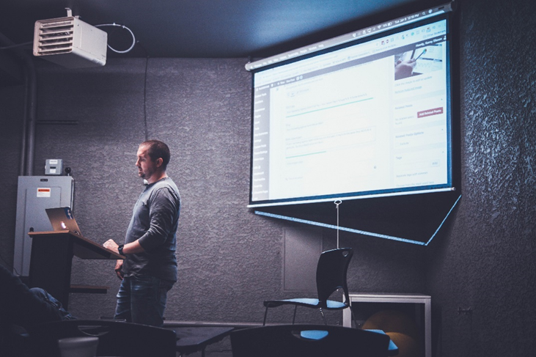
BACKGROUND
Slides keep an audience's attention during a presentation to provide additional supporting.
Checking the aesthetic quality of the slides and create textual error free quality slide.
IT17535090 | Wedage C.V. | 21_22-J 02

Slide 46
RESEARCH QUESTION
To create self-train web application to cater personal coach to check presentation slide quality by analyzing input pptx.
Detect mistakes by Checking the accuracy of the content using grammar checker.
IT17535090 | Wedage C.V. | 21_22-J 02

Slide 47
OBJECTIVES
Do the proofreading and check the presentation slides accuracy.
Aesthetic-aware slides to image synthesis.
As optional check the relevancy of the presentation topic with the content of the slides.
IT17535090 | Wedage C.V. | 21_22-J 02

Slide 48
RESEARCH METHODOLOGY
RESEARCH METHODOLOGY
IT17535090 | Wedage C.V. | 21_22-J 02

Slide 49
PROGRESS
Colors Detection
Generate ratios
Quantify sharpness
Grammar checker
Identify color contrast
Grammar Checker
Expert system for generate feedback.
System Integration.
COMPLETED(50%)
90% Progress Presentation
Final Presentation
IT17535090 | Wedage C.V. | 21_22-J 02

Slide 50
CURRENT PROGRESS
Detect colors from input presentation slides and Generate ratios according to the detected colors.
Completed color cube accuracy according to WCAG levels, get the output values with most legible pairs and hoover text.
Checked contrast for the background and foreground.
According to Web Content Accessibility Guidelines (WCAG) 2.0, text and images of text should have a minimum contrast ratio of 4.5:1 (Level AA), while large text should have minimum contrast ratio of 3:1.
Quantify sharpness using quantify sharpness algorithm and get the score.
IT17535090 | Wedage C.V. | 21_22-J 02

Slide 51
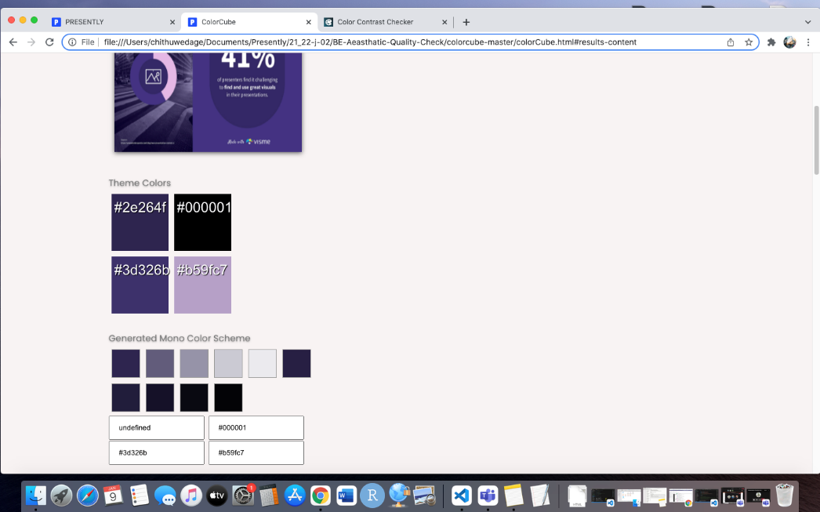
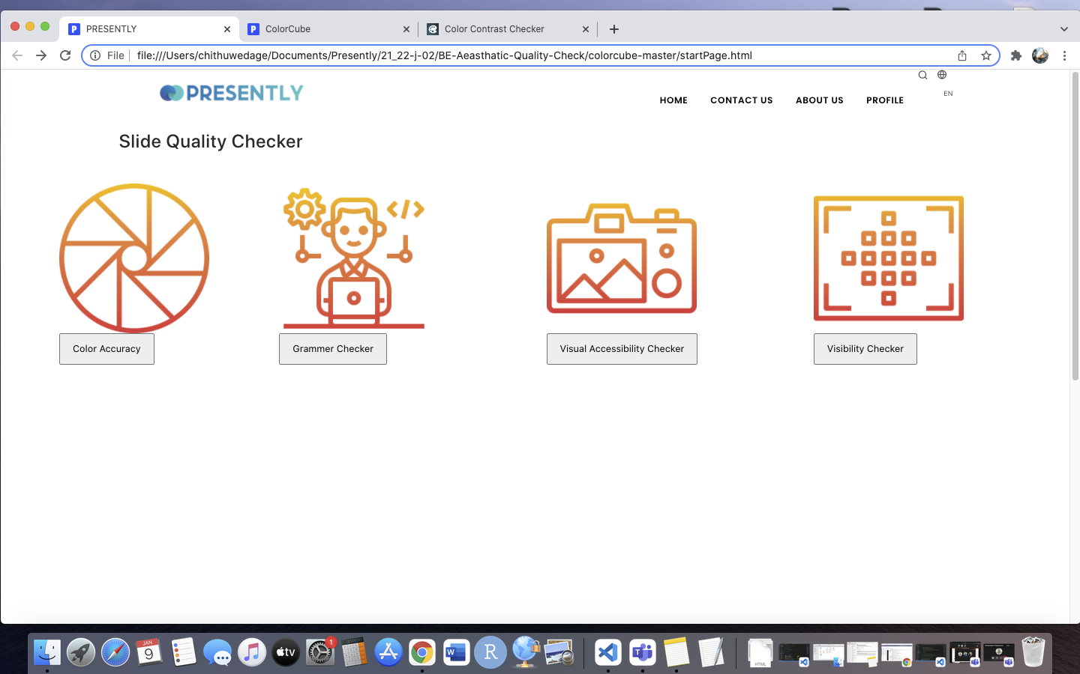
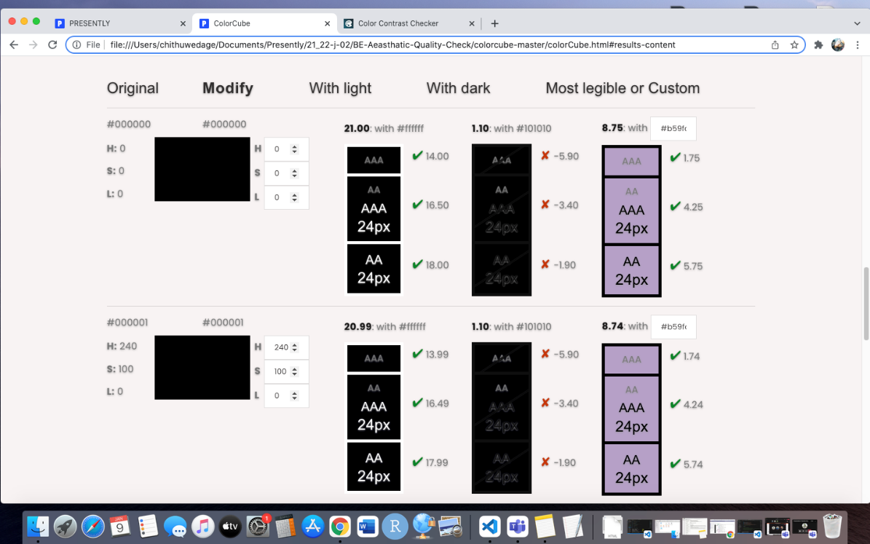
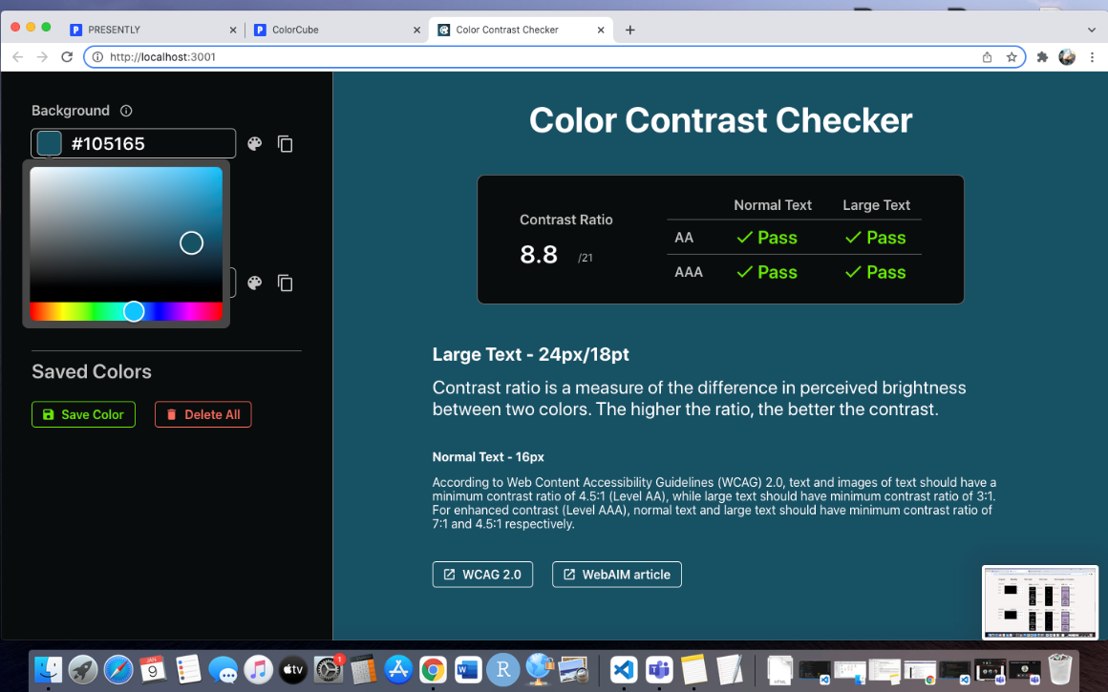
ACHIEVEMENTS
IT17535090 | Wedage C.V. | 21_22-J 02

Slide 52
TASKS TO BE COMPLETED
Advanced grammar checker
Feedback Generation
System Integration
IT17535090 | Wedage C.V. | 21_22-J 02

Slide 53



TOOLS & TECHNOLOGIES
Google Colab
NLP with Python NLTK
Python 3.9
TensorFlow
Bootstrap
IT17535090 | Wedage C.V. | 21_22-J 02

Slide 54
FUNCTIONAL REQUIREMENTS
NON-FUNCTIONAL REQUIREMENTS
Obtain a presentation slide to get aesthetic analysis.
Received final feedback (output) for the uploaded presentation and slides.
Performance
Correctness
Availability
IT17535090 | Wedage C.V. | 21_22-J 02

Slide 55
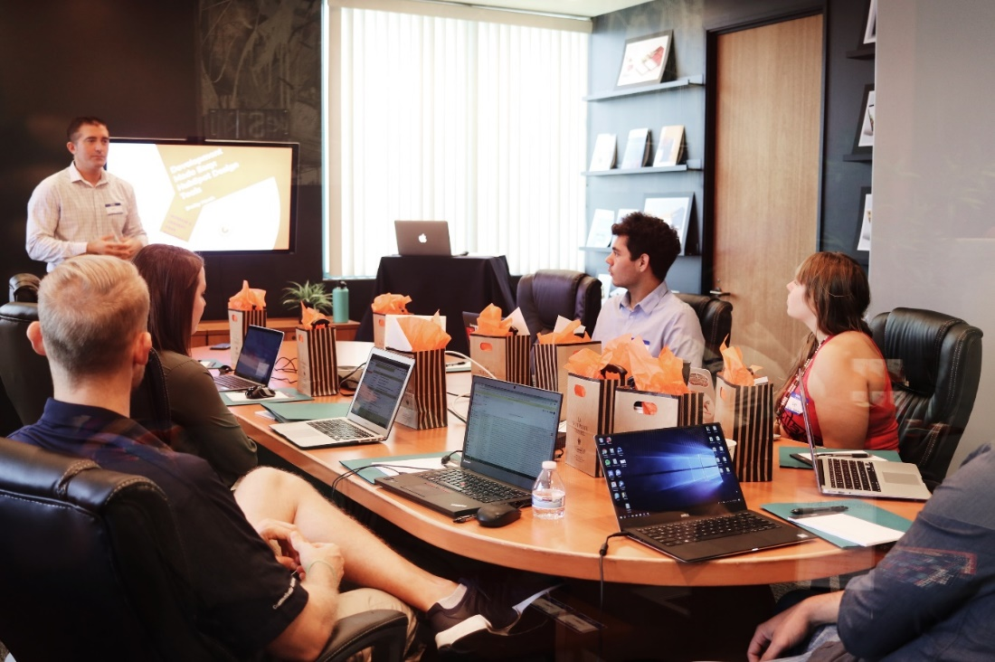
COMMERCIALIZATION
Target Audience
Employees in any industry
University Students and lecturers
Free Application
Free Access to the application
Advertisement
1 2
Stage Stage
Free Advertisement Fee

Slide 56

Thank You !
Team
21_22-J 02

Slide 57
Any Questions?
Team
21_22-J 02

